Slide 1


Library Management System
Streamlining the book borrowing experience for students and librarians through innovative technology solutions.
by BITLA SRI HARI .

Slide 2

Design Thinking: Understand User Challenges
1
Book Availability
2
Efficient Checkout
Provide real-time visibility into which books are currently in stock and on the shelves.
Simplify the checkout process to save time and frustration for both librarians and students.
3
Overdue Notifications
Proactively remind students of upcoming due dates to avoid late fees.

Slide 3
Online Search and Real-Time Availability
Comprehensive Catalog
In-Stock Visibility
Reserve Books
Allow students to search the entire library collection from any device.
Display real-time information on which books are currently available on the shelves.
Enable students to reserve books that are currently checked out and be notified when available.

Slide 4
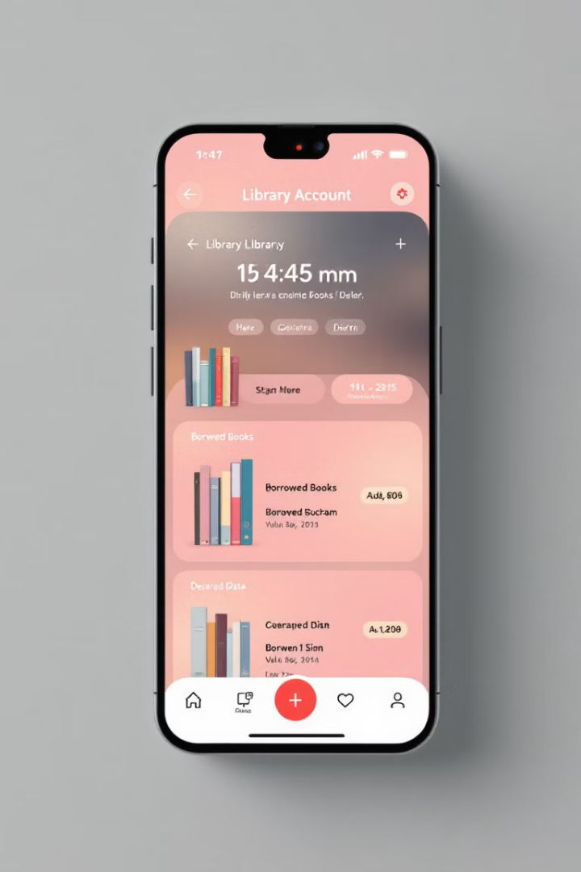
Borrowing History and Overdue Notifications
1
Borrowing History
Students can easily track their current and past book checkouts through their online account.
2
Overdue Reminders
Automated notifications alert students of upcoming due dates to avoid late fees.
3
Renewal Options
Students can renew books directly from their account if no other holds are placed.

Slide 5

Java Servlets for User Interactions
Search Books
Reserve Books
Servlet handles requests to search the library catalog and display availability.
Servlet processes book reservation requests and updates the database.
Checkout History
Overdue Notifications
Servlet retrieves a student's borrowing history from the database.
Servlet sends automated email and push notifications for upcoming due dates.

Slide 6




JDBC for Database Integration
Book Catalog
Store book details, availability, and hold status in the database.
Student Accounts
Maintain student information, borrowing history, and overdue fines.
JDBC Integration
Leverage JDBC to seamlessly connect the Java application to the database.

Slide 7




Optimizing the Checkout Process
Book Selection
Students can easily find and select the books they need.
Checkout Confirmation
The system quickly processes the checkout and provides a receipt.
Due Date Notification
Students are informed of the due dates to avoid late fees.

Slide 8

Conclusion and Next Steps
The Library Management System streamlines the book borrowing experience, empowering students and librarians with efficient tools and real-time information. Future enhancements may include mobile apps, e-book integrations, and personalized recommendations.

